Slide 1
Liberia Ebola SitRep no. 97
Ministry of Health and Social Welfare
Aug 20, 2014

Slide 2
Cases
 | National | Bomi County | Bong County | Grand Bassa | Grand Cape Mount | Grand Gedeh | Lofa County | Margibi County | Montserrado County | Nimba County | RiverCess County | Sinoe County
New Case/s (Suspected) | 20 | 0 | 7 | 0 | 0 | 0 | 1 | 3 | 9 | 0 | 0 | 0
New Case/s (Probable) | 27 | 0 | 0 | 0 | 0 | 0 | 14 | 4 | 7 | 2 | 0 | 0
New case/s (confirmed) | 18 | 0 | 0 | 0 | 0 | 0 | 18 | 0 | 0 | 0 | 0 | 0
Total suspected cases | 259 | 4 | 61 | 8 | 1 | 1 | 62 | 27 | 83 | 12 | 0 | 0
Total probable cases | 552 | 28 | 29 | 1 | 3 | 0 | 260 | 32 | 162 | 37 | 0 | 0
Total confirmed cases | 263 | 9 | 20 | 6 | 4 | 0 | 144 | 27 | 43 | 8 | 1 | 1
Total Number of Confirmed Cases of Sierra Leonean Nationality | 13 | 0 | 0 | 0 | 2 | 0 | 11 | 0 | 0 | 0 | 0 | 0
Total Number of Confirmed Cases of Guinean Nationality | 0 | 0 | 0 | 0 | 0 | 0 | 0 | 0 | 0 | 0 | 0 | 0
Cumulative (confirmed, probable, suspected) cases | 1074 | 41 | 110 | 15 | 8 | 1 | 466 | 86 | 288 | 57 | 1 | 1

Slide 3
Cases among HCWs
 | National | Bomi County | Bong County | Grand Bassa | Grand Cape Mount | Grand Gedeh | Lofa County | Margibi County | Montserrado County | Nimba County | RiverCess County | Sinoe County
Newly Reported Cases in HCW on 20th Aug 2014 | 0 | 0 | 0 | 0 | 0 | 0 | 0 | 0 | 0 | 0 | 0 | 0
Cumulative cases among HCW | 115 | 4 | 24 | 3 | 3 | 0 | 17 | 23 | 40 | 1 | 0 | 0
Newly Reported deaths in HCW on 20th Aug 2014 | 3 | 0 | 1 | 0 | 0 | 0 | 2 | 0 | 0 | 0 | 0 | 0
Cumulative deaths among HCW | 61 | 4 | 5 | 0 | 0 | 0 | 15 | 16 | 21 | 0 | 0 | 0

Slide 4
Isolation and Discharges
 | National | Bomi County | Bong County | Grand Bassa | Grand Cape Mount | Grand Gedeh | Lofa County | Margibi County | Montserrado County | Nimba County | RiverCess County | Sinoe County
New Admission on Aug 20 2014 | 15 | 0 | 0 | 0 | 0 | 0 | 15 | 0 | 0 | 0 | 0 | 0
Total no. currently in Treatment Units | 82 | 0 | 0 | 0 | 0 | 0 | 82 | 0 | 0 | 0 | 0 | 0
Total discharges on 20th Aug 2014 | 7 | 0 | 0 | 0 | 0 | 0 | 7 | 0 | 0 | 0 | 0 | 0
Cumulative admission/isolation | 82 | 0 | 0 | 0 | 0 | 0 | 82 | 0 | 0 | 0 | 0 | 0

Slide 5
Deaths
 | National | Bomi County | Bong County | Grand Bassa | Grand Cape Mount | Grand Gedeh | Lofa County | Margibi County | Montserrado County | Nimba County | RiverCess County | Sinoe County
Newly reported deaths 20th Aug 2014 | 23 | 0 | 3 | 0 | 0 | 0 | 7 | 3 | 7 | 3 | 0 | 0
Total death/s in confirmed cases | 216 | 8 | 10 | 1 | 4 | 0 | 101 | 23 | 62 | 7 | 0 | 0
Total death/s in probable cases | 265 | 6 | 11 | 1 | 1 | 0 | 100 | 26 | 99 | 20 | 1 | 0
Total death/s in suspected cases | 132 | 0 | 13 | 0 | 2 | 1 | 34 | 19 | 57 | 6 | 0 | 0
Total death/s in confirmed, probable, suspected cases | 613 | 14 | 34 | 2 | 7 | 1 | 235 | 68 | 218 | 33 | 1 | 0
Case Fatality Rate (CFR) - Confirmed & Probable Cases | 59.0 | 37.8 | 42.9 | 28.6 | 71.4 | 0.0 | 49.8 | 83.1 | 78.5 | 60.0 | 100.0 | 0.0

Slide 6
Contacts
 | National | Bomi County | Bong County | Grand Bassa | Grand Cape Mount | Grand Gedeh | Lofa County | Margibi County | Montserrado County | Nimba County | RiverCess County | Sinoe County
Newly reported contacts on 20th Aug 2014 | 196 | 0 | 39 | 0 | 0 | 0 | 31 | 31 | 78 | 17 | 0 | 0
Total contacts listed | 2643 | 64 | 339 | 10 | 31 | 0 | 552 | 137 | 1306 | 198 | 6 | 0
Currently under follow-up | 1723 | 54 | 241 | 10 | 27 | 0 | 415 | 114 | 718 | 140 | 4 | 0
Contacts seen on 20th Aug 2014 | 1536 | 0 | 165 | 0 | 27 | 0 | 415 | 114 | 675 | 140 | 0 | 0
Contacts who completed 21 day follow-up | 115 | 0 | 0 | 0 | 0 | 0 | 43 | 0 | 4 | 68 | 0 | 0
Contacts lost to follow-up | 0 | 0 | 0 | 0 | 0 | 0 | 0 | 0 | 0 | 0 | 0 | 0

Slide 7
Laboratory
 | National | Bomi County | Bong County | Grand Bassa | Grand Cape Mount | Grand Gedeh | Lofa County | Margibi County | Montserrado County | Nimba County | RiverCess County | Sinoe County
Specimens collected on 20th Aug 2014 | 41 | 0 | 2 | 0 | 0 | 0 | 38 | 0 | 0 | 1 | 0 | 0
Specimens pending for testing | 99 | 0 | 8 | 2 | 1 | 0 | 38 | 4 | 16 | 30 | 0 | 0
Total specimens tested | 19 | 0 | 0 | 0 | 0 | 0 | 19 | 0 | 0 | 0 | 0 | 0

Slide 8
Ebola Disease Outbreak (March 22-Aug 20, 2014)
Table 3: Cumulative Ebola Disease Outbreak in Liberia (March 22 -Aug 20, 2014)
Cases
 | National | Bomi County | Bong County | Grand Bassa | Grand Cape Mount | Grand Gedeh | Lofa County | Margibi County | Montserrado County | Nimba County | RiverCess County | Sinoe County
Total Case/s (Suspected) | 259 | 4 | 61 | 8 | 1 | 1 | 62 | 27 | 83 | 12 | 0 | 0
Total Case/s (Probable) | 554 | 28 | 29 | 1 | 3 | 0 | 262 | 32 | 162 | 37 | 0 | 0
Total case/s (confirmed) | 269 | 9 | 20 | 6 | 4 | 0 | 148 | 29 | 43 | 8 | 1 | 1
Cumulative (confirmed, probable, suspected) cases | 1082 | 41 | 110 | 15 | 8 | 1 | 472 | 88 | 288 | 57 | 1 | 1
Health Care Workers
Cumulative cases among HCW | 117 | 4 | 24 | 3 | 3 | 0 | 19 | 23 | 40 | 1 | 0 | 0
Cumulative deaths among HCW | 63 | 4 | 5 | 0 | 0 | 0 | 17 | 16 | 21 | 0 | 0 | 0
Deaths
Total death/s in confirmed cases | 222 | 8 | 10 | 1 | 4 | 0 | 105 | 25 | 62 | 7 | 0 | 0
Total death/s in probable cases | 267 | 6 | 11 | 1 | 1 | 0 | 102 | 26 | 99 | 20 | 1 | 0
Total death/s in suspected cases | 135 | 0 | 13 | 0 | 2 | 1 | 35 | 20 | 58 | 6 | 0 | 0
Total death/s in confirmed, probable, suspected cases | 624 | 14 | 34 | 2 | 7 | 1 | 242 | 71 | 219 | 33 | 1 | 0
Cumulative CFR (March 22 - Aug 20, 2014) | 59.4 | 37.8 | 42.9 | 28.6 | 71.4 | ##### | 50.5 | 83.6 | 78.5 | 60.0 | 100.0 | 0.0

Slide 9
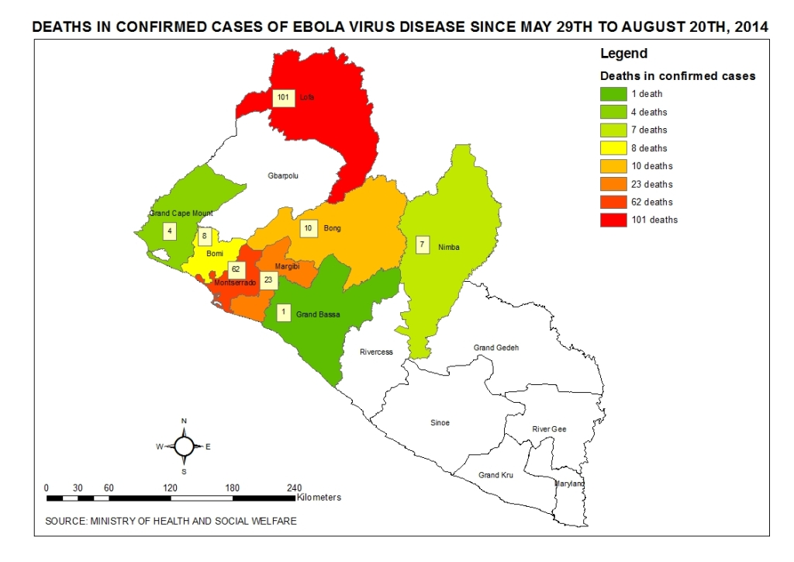
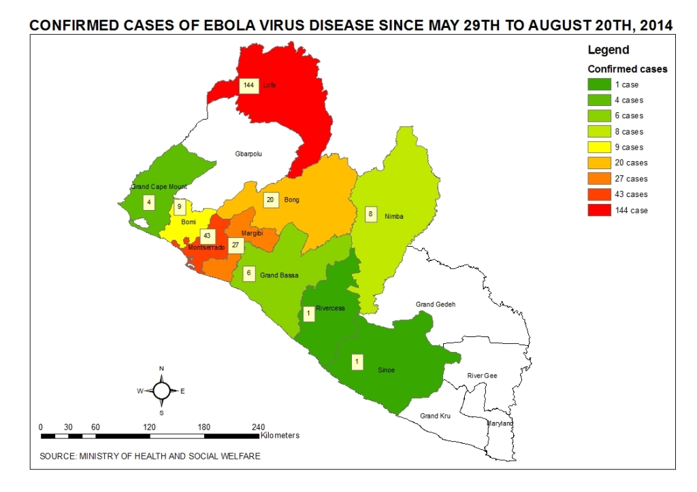

Slide 11
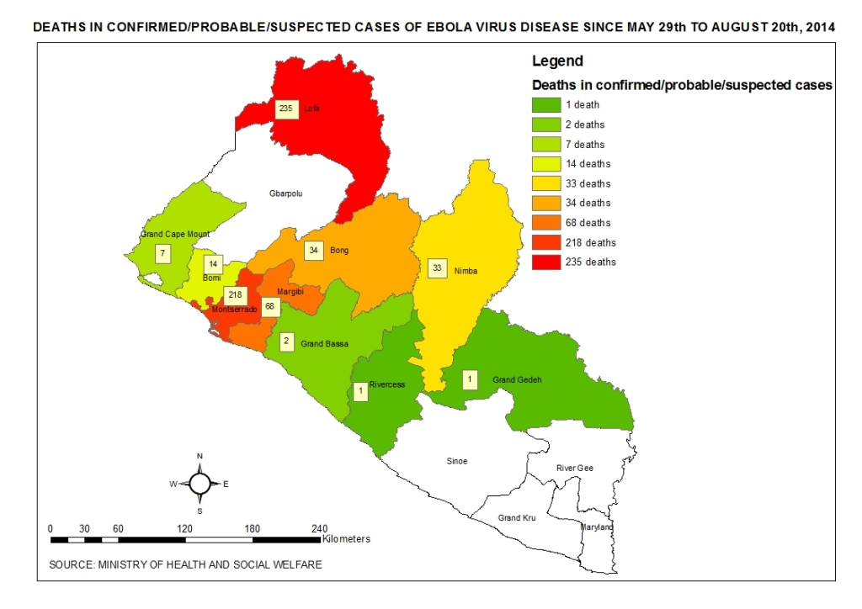

Slide 12
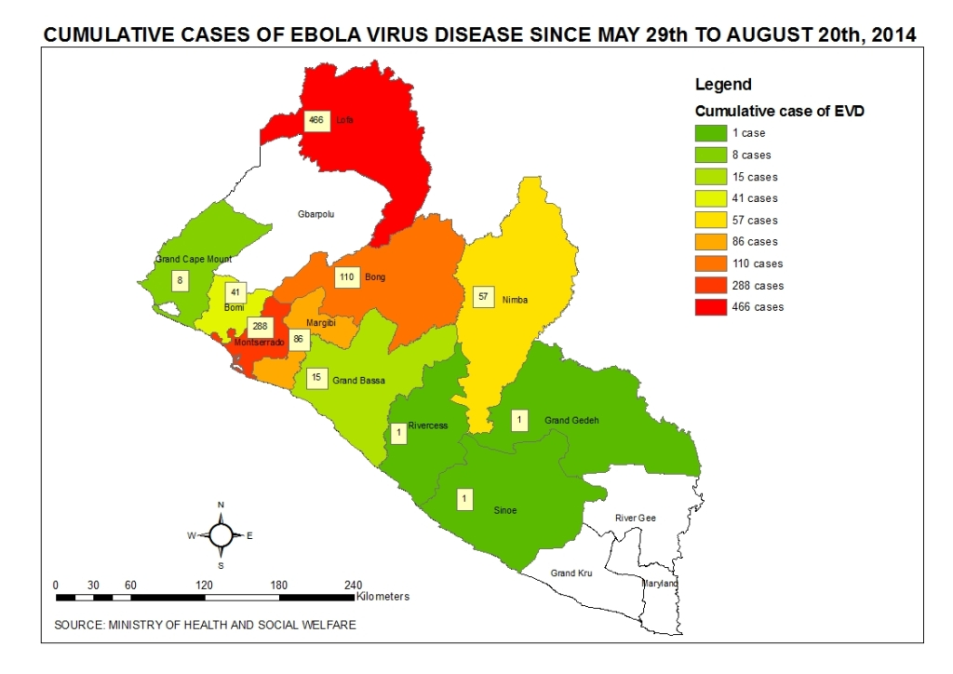

Slide 13
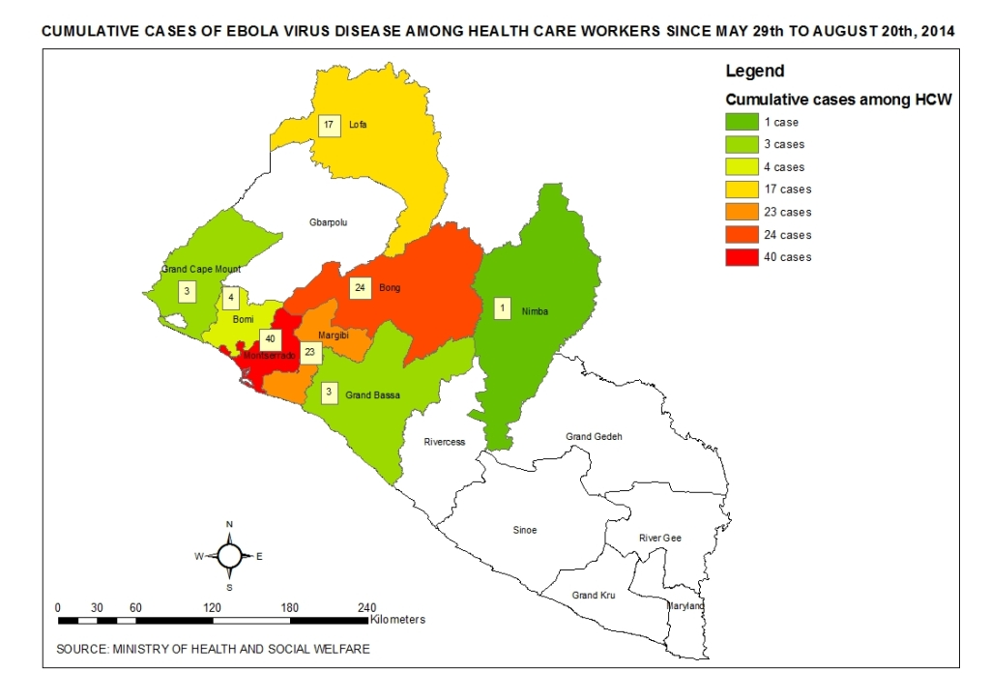

Slide 14
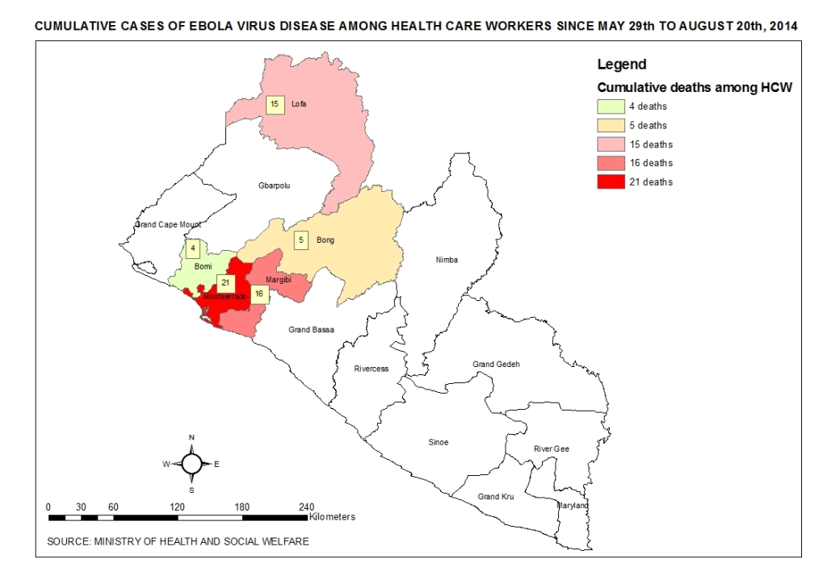

Slide 15
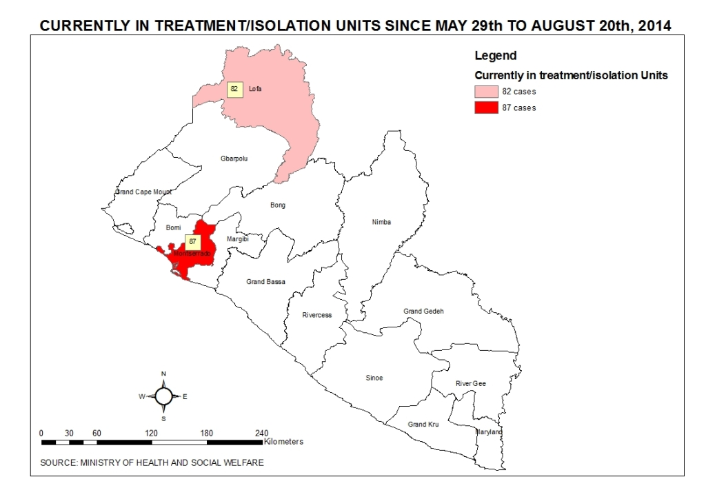

Slide 16
Case Investigation
Daily Case investigation
Date: August 19, 2014 __________ | Montserrado | Lofa | Bong | Margibi | Cape Mount | Nimba | Rivercess | Bassa | Bomi
•# of calls received | 79 | 2 | 1 | 3 | 0 | 3 | 0 | 0 | 1
•# of calls responded to | 25 | 2 | 1 | 2 | 0 | 0 | 0 | 0 | 1
•# of cases referred to treatment unit | 9 | 0 | 0 | 0 | 0 | 0 | 0 | 0 | 0
•# of suspected Cases | 11 | 2 | 1 | 2 | 0 | 0 | 0 | 0 | 1
•# of probable cases | 10 | 0 | 0 | 0 | 0 | 2 | 0 | 0 | 0
•# of suspected or probable cases with specimen taken | 0 | 0 | 0 | 0 | 0 | 2 | 0 | 0 | 0
•# of bodies | 20 | 2 | 1 | 2 | 0 | 3 | 0 | 0 | 1
•# of bodies with specimen taken | 2 | 0 | 0 | 0 | 0 | 1 | 0 | 0 | 0
•# homes sprayed | 0 | 0 | 0 | 0 | 0 | 0 | 0 | 0 | 0
•# of psychosocial counseling done | 25 | 2 | 1 | 2 | 0 | 3 | 0 | 0 | 1
# of cases pending transfer | 0 | 0 | 0 | 0 | 0 | 0 | 0 | 0 | 0

Slide 17
Highlights
Case Investigation
A total of 9 cases transferred to MSF ETU up to reporting time.
Nimba County reported 2 new probable cases with 1 sample taken and 3 new deaths.
A Total of 20 bodies were removed from communities and ETUs in Montserrado

Slide 18
Montserrado Highlights
One of the monitor could not be reached today by the CSO so the day’s report is minus one tracing team
There is a growing number of cases lost to follow up. There is growing concern that contacts are running away thereby making contact tracing ineffective

Slide 19
Nimba Highlights
11 new Probable contact listed
3 new probable Ebola related death
15 body bags were sent to the County
The county Task Force is negotiating with the Central Government to quarantine Nimba
Renovation of the holding center by Arcelor Mittal at G. W. Harley and Ganta Hospitals is ongoing
Issues & Constraints
The Ebola burial team in Ganta are making high financial demand for burial
No Vehicle for spraying team

Slide 20
Nimba Highlights
11 new Probable contact listed
3 new probable Ebola related death
15 body bags were sent to the County
The county Task Force is negotiating with the Central Government to quarantine Nimba
Renovation of the holding center by Arcelor Mittal at G. W. Harley and Ganta Hospitals is ongoing
Issues & Constraints
The Ebola burial team in Ganta are making high financial demand for burial
No Vehicle for spraying team

